Slide 1
1-1
18B/10B Encoder and Decoder
2015.1
Notes:
This module identifies the 8B/10B code groups and describes how DC balance is maintained in a serial data stream and how a clock is recovered from a serial data stream. Encoder and decoder port names are also described. Encoding for the Kintex®-7 and Virtex®-7 FPGA GTX is covered in this module. Artix®-7 FPGA GTP encoding is the same. 30 minutes.

Slide 2

Objectives
1-2
27375**slide
After completing this module, you will be able to:
List the two types of 8B/10B code groups
Explain how DC balance is maintained in a serial data stream Explain how a clock is recovered from a serial data stream Define the various encoder and decoder port names
在串行数据通信中，例如HDMI，字节数据会被转化为10位字符，这个过程称为8B/10B编码。这种编码方案旨在确保可靠的数据传输，帮助时钟恢复，并保持信号完整性。 8B/10B编码方案的关键特点包括： 1、过渡密度： 字符集被精心选择，以优化过渡密度。这意味着编码旨在在数据流中保持0到1和1到0的过渡平衡。这个特性有助于时钟恢复，使接收器更容易从数据流中提取时钟信号。 2、限制连续位数： 为了防止连续1或0的长时间运行，这可能导致同步丢失和信号退化，8B/10B编码确保不会传输超过五位连续相同值的位。 3、边沿过渡和抖动减少： 该编码保证了边沿过渡，从而减少确定性抖动，有助于在较长距离上保持信号质量。 4、固定字符集： 在收发器中使用的8B/10B字符集是标准化且固定的。这个字符集在各种高速通信协议中保持一致，包括千兆以太网、XAUI、光纤通道和InfiniBand。 5、特殊字符： 在8B/10B编码中，存在称为“K字符”的特殊字符。这些K字符用于控制和管理链接。它们提供了对齐、错误检测和同步等功能。 总体而言，8B/10B编码方案对于在高速串行通信系统（如HDMI）以及其他各种网络和数据传输协议中保持信号完整性、时钟恢复和可靠的数据传输至关重要。

Slide 3
Overview
1-3
27376**slide
Overview
8B/10B Encoding
Data, Encoder, and Decoder Ports
Using 8B/10B Encoding
Other Encoding Schemes
Summary

Slide 4
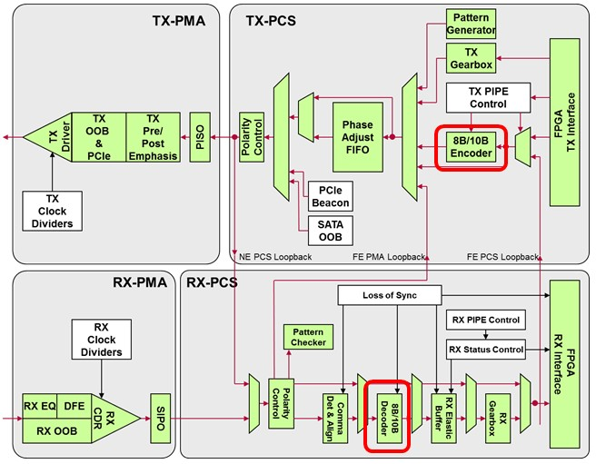
8B/10B Encoder and Decoder
1-4
Notes:
In this module, you will identify how the serial transceiver automatically encodes and decodes data via an 8B/10B encoding scheme. The DFE in the receiver part is supported by GTX and GTH only.

Slide 5
Encoding Motivation
串行数据传输需要时钟嵌入到数据流中。每个串行收发器内的接收器执行时钟和数据恢复（CDR），而这个电路需要一个过渡丰富的数据流来维持相位和频率锁定。8B/10B编码提供了足够数量的过渡，同时需要保持直流平衡。
1-5
27378**slide
Serial data transmission requires the clock to be embedded in the data stream
The receiver within each serial transceiver performs Clock and Data Recovery (CDR), and this circuitry needs a transition-rich data stream to maintain phase and frequency locking
8B/10B encoding provides a sufficient number of transitions DC balance also needs to be maintained
—
Send the same number of 1s and 0s
Excessive runs of 1s or 0s cause the line to charge and discharge, moving the common-mode voltage
Causes more deterministic jitter
Increases Bit Error Rate (BER)
—
发送相同数量的1和0。过多的连续1或0会导致线路充电和放电，从而改变共模电压。会引起更多的确定性抖动。增加误码率（BER）。
Notes:
From Wikipedia: An encoder is a device used to change a signal (such as a bitstream) or data into a code. The code may serve any of a number of purposes, such as compressing information for transmission or storage, encrypting or adding redundancies to the input code, or translating from one code to another. This is usually done by means of a programmed algorithm, especially if any part is digital, while most analog encoding is done with analog circuitry. Facilitator_Block_Start Signal changes are needed on the line for the CDR at receive side → encoding. DC balancing is needed to have the DC level in the middle → running disparity.

Slide 6
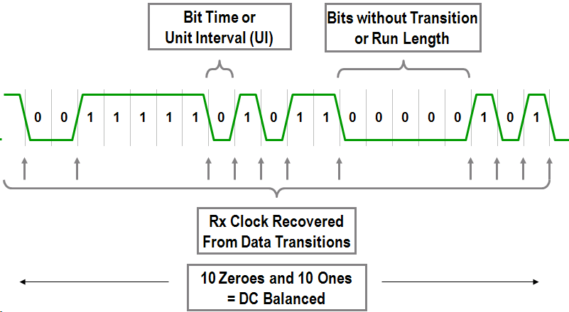
Serial Waveform
1-6
Notes:
A bit time or Unit Interval (UI) is used to measure parameters of the serial data stream, such as jitter. The run length is the number of consecutive identical bits that can be sent before the receiver PLL loses the recovered clock. The concept of DC balance is explained in more detail in the next slide.

Slide 7
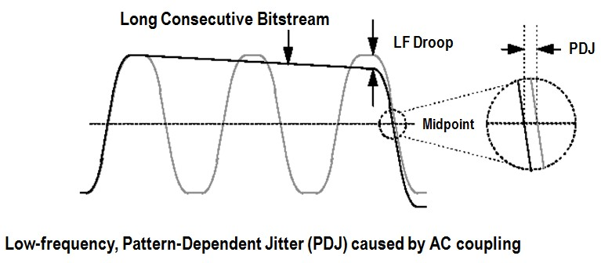
DC Balancing and AC Coupling
连续的长串1或0可能会引起低频率、与模式相关的抖动。
1-7
27380**slide
Maintaining DC balance is critical for AC-coupled applications
—
Long strings of consecutive 1s or 0s can cause low-frequency, pattern-dependent jitter
Notes:
More information on this can be found in the Choosing AC-Coupling Capacitors application note (www.maxim-ic.com/appnotes.cfm/appnote_number/292): “When using AC-coupling in optical transceiver design, care should be taken to minimize the pattern-dependent jitter associated with the low-frequency cutoff of the AC-coupling network. When NRZ data containing long strings of identical 1s or 0s is applied to this high-pass filter, a voltage droop occurs, resulting in low-frequency, Pattern-Dependent Jitter (PDJ). This can be understood as illustrated in the figure…”

Slide 8
8B/10B Encoding
1-8
Overview
8B/10B Encoding
Data, Encoder, and Decoder Ports
Using 8B/10B Encoding
Other Encoding Schemes
Summary
Notes:
This lesson describes encoding.

Slide 9
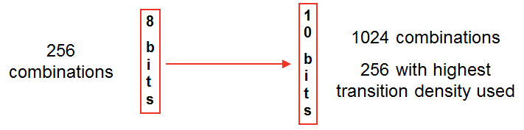
8B/10B Encoding
1-9
27382**slide
Bytes are translated into 10-bit characters
—
The character set is chosen for transition density (to allow for clock recovery) by ensuring that no more than five consecutive 1s or 0s are transmitted
Guaranteed edge transition and reduced deterministic jitter
8B/10B character set of the transceiver is fixed; same for Gigabit Ethernet, XAUI, Fibre Channel, and InfiniBand
—
Twelve special K characters are used to control the link
Notes:
From Wikipedia: In telecommunications, 8B/10B is a line code that maps 8-bit symbols to 10-bit symbols to achieve DC-balanced and bounded disparity, and yet provides enough state changes to allow reasonable clock recovery. This means that the difference between the count of 1s and 0s in a string of at least 20 bits is no more than 2, and that there are not more than five 1s or 0s in a row. This helps to reduce the demand for the lower bandwidth limit of the channel necessary to transfer the signal. 8B/10B Trade-Offs 8B/10B Benefits
8B/10B Costs
DC Balanced: No increase in bit errors due to line charging on AC-coupled channels.
Two-bit overhead per byte: Every byte transmitted is mapped to a 10-bit character. As a result, 20% of the channel bandwidth is consumed for overhead.
Limited Run Lengths: The maximum number of bits without a transition i s5, making it easy for receivers to achieve and maintain lock.
Both sides of the channel must use 8B/10B. 8B/10B data must be decoded before it can be used.
Error Detection: All single-bit errors and many multibit errors can be detected using disparity and out of table error checking.
Control Characters: 8B/10B allows bytes to be marked as control characters. This feature is heavily used in many standard protocols.

Slide 10
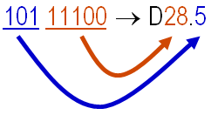

Code Groups
8B/10B编码方案中存在两种类型的编码组：数据（D）组和特殊（K）组。这些编码组被称为Dx.y或Kx.y，其中x对应于输入八位字节的最低有效五位，而y对应于最高有效三位。实现过渡密度、时钟恢复和数据传输的目标。
1-10
27383**slide
For each 8-bit input (or octet), there is a corresponding 10-bit code group
—
Two types of code groups: data (D) groups and special (K) groups
Groups are termed Dx.y or Kx.y, where x corresponds to the least significant five bits of the incoming octet, and y corresponds to the most significant three bits
A ninth input to the 8B/10B encoder indicates special characters
—
—
Examples
10-bit data: + 0011101010, –
0011101010
10-bit data: + 1101011001, –
0010101001
8B/10B Encoder and Decoder - 1-10
Notes:
For more information, see the 8B/10B table in the 7 Series FPGAs Transceivers User Guides, in the Valid 8B/10B Characters section.

Slide 11
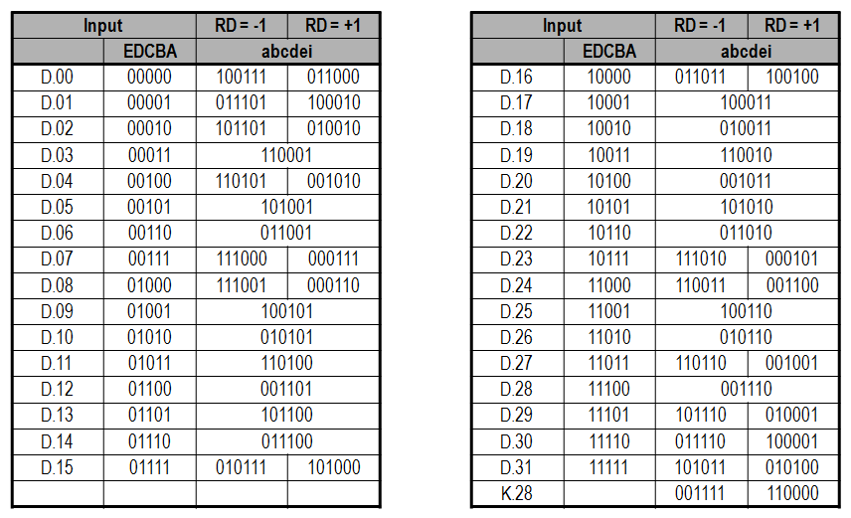
Low 5 Bits: 5B/6B Encoding
1-11
Notes:
A and a are the least significant bits.

Slide 12
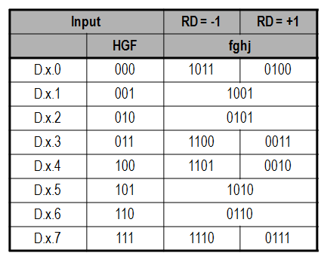
Top 3 Bits: 3B/4B Encoding
1-12
27385**slide
Encoding Rules:
Perform 5B/6B encoding
Perform 3B/4B encoding
Combine the two parts
Start with the result from (1)
Add the result from (2) with the rules
o o o
If (1) has more 1s, Use (2) with more 0s If (1) has more 0s, Use (2) with more 1s
If (1) has three 1s and three 0s, Use (2) with more 1s
如果步骤(1)中有更多的1，使用步骤(2)中更多的0
如果步骤(1)中有更多的0，使用步骤(2)中更多的1
如果步骤(1)中有三个1和三个0，使用步骤(2)中更多的1
这些编码规则描述了在8B/10B编码中如何将5B/6B编码和3B/4B编码两部分结合在一起。通过按照规则组合不同的编码结果，可以实现8位数据到10位编码的映射，同时保持过渡密度和时钟恢复的要求。

Slide 13
Running Disparity (1)
1-13
27386**slide
A given code word can have more ones than zeros or vice versa
Running Disparity (RD) indicates whether the last transmitted code had an excess of 1s (positive disparity) or an excess of 0s (negative disparity)
—
Neutral disparity characters still have + and – disparity, but will not change the RD value
Correct running disparity is automatically maintained by the transceiver
—
RD can be changed for specific standards via control ports
一个给定的编码字可以有比0更多的1，或者反过来。
Running Disparity (RD) 表示上一个传输的编码是否有过多的1（正差异）或过多的0（负差异）。
中性差异字符仍然具有+和-的差异，但不会改变RD值。
正确的运行差异由收发器自动维护。
通过控制端口，可以为特定标准更改RD。RD是衡量1和0 的差异的标志位。
Notes:
Running disparity: • 8B/10B uses running disparity to balance the number of ones and zeros transmitted. Whenever a character is transmitted, the encoder recalculates the running disparity. The current TX running disparity can be read from the TXCHARDISP port. This running disparity is calculated several cycles after TXDATA is clocked into the FPGA TX interface, so it cannot be used to decide the next value to send, as required in some protocols. • Normally, running disparity is used to determine whether a positive or negative 10-bit code is transmitted next. The encoder allows the next disparity value to be controlled directly as well, to accommodate protocols that use disparity to send control information. For example, an idle character sent with reversed disparity might be used to trigger clock correction. If a code word with no disparity is sent, RD is not inverted. For example: The code words for D28.5 both have equal numbers of 1s and 0s. When D28.5 is transmitted, the value of RD is not changed. Maintain DC balance so that you can minimize your Bit Error Rate (BER). If more 1s than 0s are sent across the line, the line will begin to charge up (or discharge if more 0s than 1s), causing the common-mode voltage to drift and leading to more errors.

Slide 14

Running Disparity (2)
90394**slide
To maintain DC balance, the next transmitted code word can have the opposite disparity of the running disparity
1-14
—
RD is a single-bit signal, initialized to 0 RD is calculated on each transmitted byte
No toggling if the sequence is still balanced
In aggregate, an equal number of 1s and 0s are transmitted
—
—
为了维持直流平衡，下一个传输的编码字可以具有与运行离散度相反的离散度。运行离散度（RD）是一个单比特信号，初始值为0，它会在每个传输的字节中进行计算。如果序列仍然保持平衡，则不会发生切换。总体上，传输的1和0的数量是相等的。
Notes:
Running disparity: • 8B/10B uses running disparity to balance the number of ones and zeros transmitted. Whenever a character is transmitted, the encoder recalculates the running disparity. The current TX running disparity can be read from the TXCHARDISP port. This running disparity is calculated several cycles after TXDATA is clocked into the FPGA TX interface, so it cannot be used to decide the next value to send, as required in some protocols. • Normally, running disparity is used to determine whether a positive or negative 10-bit code is transmitted next. The encoder allows the next disparity value to be controlled directly as well, to accommodate protocols that use disparity to send control information. For example, an idle character sent with reversed disparity might be used to trigger clock correction. If a code word with no disparity is sent, RD is not inverted. For example: The code words for D28.5 both have equal numbers of 1s and 0s. When D28.5 is transmitted, the value of RD is not changed. Maintain DC balance so that you can minimize your Bit Error Rate (BER). If more 1s than 0s are sent across the line, the line will begin to charge up (or discharge if more 0s than 1s), causing the common-mode voltage to drift and leading to more errors.

Slide 15
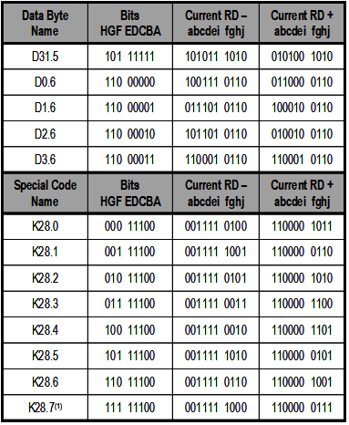

8B/10B Data Encoding with Disparity
每个给定的编码组有两个编码字，一个编码字有比0更多的1（+离散度），另一个编码字有比1更多的0（-离散度）。一些编码字有相等数量的1和0（零离散度）。为了维持直流平衡，当前所需的运行离散度决定了要传输哪个编码字。
1-15
27387**slide
How?
—
Any given code group has two code words One word has more 1s than 0s (+ disparity) and vice versa
Some code words have an equal number of 1s and 0s (zero disparity)
The current RD required to maintain DC balance determines which word is transmitted
—
—
通过选择适当的编码字并在传输后反转RD，可以确保在数据传输过程中维持直流平衡。
Example: transmit data = D1.6 = 11000001
—
If RD = 1, transmit 1000100110 and invert RD
If RD = 0, transmit 0111010110 and invert RD
—
Notes:
8B/10B takes an 8-bit input and encodes it to a 10-bit output. 2exp8 data patterns are defined.

Slide 16
Control Characters
1-16
27388**slide
Twelve special characters (K characters) are defined for control
Three of the twelve K characters are commonly used for alignment (comma character)
K-character sequence encoding is independent from the data sequence
Byte alignment logic will correctly align to the data sequence
When transmitting, the user application must assert a flag to tell the transceiver that the current character is a K character
The receiver flag indicates the incoming K character
Plus and minus disparity symbols are complements
Easier for symbol detection Example: K28.5– = 001111 1010
K28.5+ = 110000 0101
—
—
—
K28.1, K28.5, K28.7
All start with 001111 10xx (K28.x) More on this later
—
—
—
K28.1，K28.5，K28.7
所有这些字符都以001111 10xx（K28.x）开头，后面的xx表示具体的编号。稍后将详细说明。
K字符序列的编码与数据序列无关
字节对齐逻辑将正确对齐数据序列
在传输时，用户应用程序必须断言一个标志，告诉收发器当前的字符是K字符
接收器标志指示传入的K字符
—
—
Notes:
K characters will not occur in serial data with any combination of two other characters. The 8B/10B table includes special characters (K characters) that are often used for control functions. To transmit TXDATA as a K character instead of regular data, the TXCHARISK port must be driven high. If TXDATA is not a valid K character, the encoder drives TXKERR high. Valid K Characters Name
Hex
8 Bits
RD -
RD +
K28.0
1C
00011100
0011110100
1100001011
K28.1
3C
00111100
0011111001
1100000110
K28.2
5C
01011100
0011110101
1100001010
K28.3
7C
01111100
0011110011
1100001100
K28.4
9C
10011100
0011110010
1100001101
K28.5
BC
10111100
0011111010
1100000101
K28.6
DC
11011100
0011110110
1100001001
K28.7
FC
11111100
0011111000
1100000111
K23.7
F7
11110111
1110101000
0001010111
K27.7
FB
11111011
1101101000
0010010111
K29.7
FD
11111101
1011101000
0100010111
K30.7
FE
11111110
0111101000
1000010111

Slide 17
Data, Encoder, and Decoder Ports
1-17
Overview
8B/10B Encoding
Data, Encoder, and Decoder Ports
Using 8B/10B Encoding
Other Encoding Schemes
Summary
Notes:
• All ports and attributes in this lesson correspond to the GTX transceiver in 7 series FPGAs. Other transceivers will be equivalent. Facilitator_Block_Start This lesson describes all the transceiver ports used for 8B/10B encoding.

Slide 18
Byte Mapping of Control and Status Ports to Data Ports
可变宽度的数据端口将FPGA芯片与传输器进行接口连接
1-18
Variable-width data ports interface the FPGA fabric with the transceiver
—
TXDATA[63:0] (input) – Transmit to the transceiver = 2, 4, or 8 bytes in parallel
RXDATA[63:0] (output) – Receive from the transceiver = 2, 4, or 8 bytes in parallel
—
The two bits of the control and status signals correlate to a specific byte of RXDATA or TXDATA
控制/状态位 数据位 控制/状态位 数据位
Control / Status Bits | Data Bits | Control / Status Bits | Data Bits
[0] | [7:0] | [4] | [39:32]
[1] | [15:8] | [5] | [47:40]
[2] | [23:16] | [6] | [55:48]
[3] | [31:24] | [7] | [63:56]
Notes:
Remember that each transceiver tile contains multiple transceivers. Ports and attributes can be set independently for each transceiver. GTP transceiver port examples: • TXDATA[63:0] – TXDATA is the bus for transmitting data. The width of this port depends on TX_DATA_WIDTH: • TX_DATA_WIDTH = 20: TXDATA[15:0] = 16 bits wide. • TX_DATA_WIDTH = 40: TXDATA[31:0] = 32 bits wide. • TX_DATA_WIDTH = 80: TXDATA[63:0] = 64 bits wide. – When the 8B/10B encoder is bypassed and TX_DATA_WIDTH is set to a multiple of 10, 10-bit characters are passed to TX data interface with this format: • The corresponding TXCHARDISPMODE represents the 9th bit • The corresponding TXCHARDISPVAL represents the 8th bit • The corresponding TXDATA byte represents [7:0] bits

Slide 19
8B/10B Encoder Status and Control Ports (I)
8B/10B编码器的状态和控制端口
1-19
27391**slide
TXCHARISK (input) – When asserted, this indicates that the current character is a K character
TXCHARDISPMODE and TXCHARDISPVAL (input) – Allows you to invert or set the running disparity of the next bytes transmitted
—
Required by some protocols for special sequences The coding is given in the notes section
—
TX8B10BEN (input) – Is set High to enable the 8B/10B encoder
—
TX_DATA_WIDTH must be set to 20, 40, or 80 (80 bit GTX/GTH only) when the 8B/10B encoder is enabled
1: 8B/10B encoder enabled
0: 8B/10B encoder bypassed. This option reduces latency
TXCHARISK（输入）- 当被断言时，表示当前字符是一个K字符
TXCHARDISPMODE和TXCHARDISPVAL（输入）- 允许您翻转或设置下一个字节传输的运行失调
某些协议需要用于特殊序列。编码详见注释部分
TX8B10BEN（输入）- 设置为高以启用8B/10B编码器
当启用8B/10B编码器时，TX_DATA_WIDTH必须设置为20、40或80（仅适用于80位GTX/GTH）1：启用8B/10B编码器.0：绕过8B/10B编码器。此选项可减少延迟
Notes:
TXCHARDISPMODE and TXCHARDISPVAL versus Outgoing Disparity 1-20 TXCHARDISPMODE and TXCHARDISPVAL versus Outgoing Disparity GTX transceiver port examples: TXCHARISK[7:0]: • TXCHARISK is set High to send TXDATA as an 8B/10B K character. TXCHARISK should only be asserted for TXDATA values representing valid K characters. – TXCHARISK[7] corresponds to TXDATA[63:56]. – TXCHARISK[6] corresponds to TXDATA[55:48]. – ... – TXCHARISK[0] corresponds to TXDATA[7:0]. • A TXCHARISK bit should be driven Low when the corresponding data byte from TXDATA is set to bypass the 8B/10B encoder. TXCHARDISPMODE[7:0]: • TXCHARDISPMODE and TXCHARDISPVAL allow the 8B/10B disparity of outgoing data to be controlled when 8B/10B encoding is enabled.

Slide 20
8B/10B Encoder Status and Control Ports (II)
1-20
27392**slide
TX8B10BBYPASS (input) – Indicates whether to use 8B/10B encoding on a per-byte basis
—
When bypassed, TXCHARDISPMODE and TXCHARDISPVAL become bits nine and eight of the 10-bit character to be transmitted
Byte | 8-Bit Data (8B/10B Enabled) | 10-Bit Data (8B/10B Bypassed)
7 | TXDATA [63:56] | { TXCHARDISPMODE[7],TXCHARDISPVAL[7], TXDATA[63:56] }
... | ... | ...
1 | TXDATA [15:8] | { TXCHARDISPMODE[1],TXCHARDISPVAL[1], TXDATA[15:8] }
0 | TXDATA [7:0} | { TXCHARDISPMODE[0],TXCHARDISPVAL[0], TXDATA[7:0] }
8B/10B Encoder and Decoder - 1-20
Notes:
GTX transceiver port examples: TX8B10BBYPASS[7:0]: • This active-High port allows byte-interleaved data to bypass 8B/10B on a per-byte basis. TX8B10BEN must be High to use this per-byte bypass mode. – TX8B10BBYPASS [7] corresponds to TXDATA[63:56] – TX8B10BBYPASS [6] corresponds to TXDATA[55:48] – TX8B10BBYPASS [5] corresponds to TXDATA[47:40] – TX8B10BBYPASS [4] corresponds to TXDATA[39:32] – TX8B10BBYPASS [3] corresponds to TXDATA[31:24] – TX8B10BBYPASS [2] corresponds to TXDATA[23:16] – TX8B10BBYPASS [1] corresponds to TXDATA[15:8] – TX8B10BBYPASS [0] corresponds to TXDATA[7:0] • TXBYPASS8B10B[x] = 1, encoder for byte x is bypassed. • TXBYPASS8B10B[x] = 0, encoder for byte x is used.

Slide 21
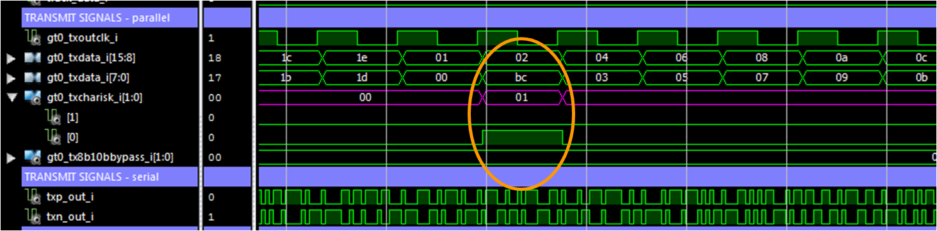
8B/10B Encoding Example
TXCHARISK用于区分是否传输K字符或者普通数据字符，从而在传输中实现特殊字符的编码。
1-21
TXCHARISK must be asserted whenever the user application wants to encode a K character
—
The 8-bit character on TXDATA must be one of the characters from the 8B/10B table
Example: BC = 1011 1100 = D28.5 or K28.5
—
If TXCHARISK is asserted, then K28.5 is transmitted
If TXCHARISK is not asserted, then D28.5 is transmitted
—
Notes:
The example designs, generated by the Wizards, use one parity bit parallel to the data bits to control K-character generation.

Slide 22
8B/10B Decoder Status and Control Ports
1-22
27394**slide
RXCHARISK (output) – Indicates that a K character was received
RXCHARISCOMMA (output) –
Indicates that an 8B/10B comma was received
RXNOTINTABLE (output) –
Indicates that an invalid 10B character has been received
RX8B10BEN (input) – Selects the use of the 8B/10B decoder in the RX datapath
If this input is Low, the literal 10-bit data comes out as {RXDISPERR, RXCHARISK, RXDATA<8 bits>}.
1: 8B/10B decoder enabled
0: 8B/10B decoder bypassed (reduces latency)
—
For more information about commas, refer to the "Commas and Deserializer Alignment" module
—
RXDISPERR (output) – Indicates that a disparity error has been detected
Notes:
GTX transceiver port examples: RXCHARISK[7:0]: • Active High indicates the corresponding byte shown on RXDATA is a K character when 8B/10B decoding is enabled. RXCHARISCOMMA[7:0]: • Active High indicates the corresponding byte shown on RXDATA is a comma character. RXDISPERR[7:0]: • Active High indicates the corresponding byte shown on RXDATA has a disparity error. • This is bit 9 of non-decoded data if the 8B/10B decoder is bypassed or the corresponding bit of RXNOTINTABLE is High. RXNOTINTABLE[7:0]: • Active High indicates the corresponding byte shown on RXDATA was not a valid character in the 8B/10B table.

Slide 23
Bypassing the 8B/10B Decoder
1-23
27395**slide
RX8B10BEN – Drive this input low to bypass the 8B/10B decoder
—
When bypassed, RXCHARISK and RXRUNDISP become bits nine and eight of the received 10-bit character
Byte | 8-Bit Data (8B/10B Enabled) | 10-Bit Data (8B/10B Bypassed)
7 | RXDATA [63:56] | { RXCHARISK[7],RXRUNDISP[7], RXDATA[63:56] }
... | . . . | . . .
1 | RXDATA [15:8] | { RXCHARISK1],RXRUNDISP[1], RXDATA[15:8] }
0 | RXDATA [7:0] | { RXCHARISK[0],RXRUNDISP[0], RXDATA[7:0] }
Notes:
GTX transceiver port examples: RX8B10BEN: • RX8B10BEN selects the use of the 8B/10B decoder in the RX datapath, just after the comma detection / realignment block. • If this input is Low, the literal 10-bit data comes out as {RXDISPERR, RXCHARISK, RXDATA<8 bits>}. – 1: 8B/10B decoder enabled – 0: 8B/10B decoder bypassed (reduces latency)

Slide 24
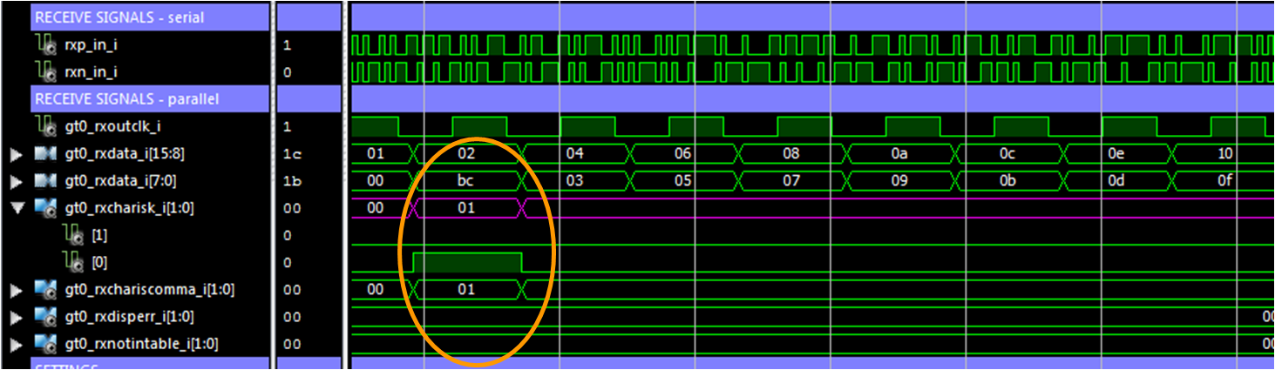
8B/10B Decoding Example
1-24
27396**slide
K characters are flagged with the assertion of RXCHARISK
—
RXCHARISK is asserted on the same clock cycle that the K character appears on RXDATA

Slide 25
Using 8B/10B Encoding
1-25
Overview
8B/10B Encoding
Data, Encoder, and Decoder Ports
Using 8B/10B Encoding
Other Encoding Schemes
Summary
Notes:
• All ports and attributes in this lesson correspond to the GTX transceiver in 7 series FPGAs. Other transceivers will be equivalent. Facilitator_Block_Start This lesson describes the steps and settings required to work with 8B/10B encoding.

Slide 26
Use of Encoding (I)
1-26
Encoding enabling
Marking of K characters to be transmitted
—
TX8B10BEN set to high – enables the encoding
TX8B10BEN set to low – disables the encoding
—
TXCHARISK[7:0] set to high – transmit data as K character TXCHARISK[7:0] set to low – transmit data as regular data
—
—
Control of Running Disparity (RD)
—
Option for protocols to use the disparity to send control information
XCHARDISPMOD E | TXCHARDISPVAL | Outgoing Disparity
0 | 0 | Normal calculation by encoder
0 | 1 | Inverts normal RD when encoding TX data
1 | 0 | Forces RD negative when encoding TX data
1 | 1 | Forces RD positive when encoding TX data
Notes:
These are the three steps to perform 8B/10B encoding. The control signals must be applied with the data.

Slide 27
Use of Encoding (II)
1-27
27399**slide
Monitoring the RD
—
No longer supported
Bypassing encoding
—
TX8B10BBYPASS[7:0] set to high – enables the bypassing
Can be used on a cycle-to-cycle basis
10-bit input code is forwarded without encoding
Notes:
Previous transceiver generations have had monitor ports.

Slide 28
Use of Decoding (I)
1-28
27400**slide
Encoding enabling
Marking of received commas
RXCHARISCOMMA[7:0] = High –indicates a received comma
If DEC_PCCOMMA_DETECT = TRUE → positive comma
If DEC_MCCOMMA_DETECT = TRUE → negative comma
To limit the indication for standard
commas (K28.1, K28.5, K28.7) only, set DEC_VALID_COMMA_ONLY to
TRUE
Typically used for Ethernet-
based applications
RXCHARISCOMMA[7:0] does not depend on
MCOMMA_10B_VALUE or PCOMMA_10B_VALUE
—
RX8B10EN set to high – enables the decoding
RX8B10EN set to low – disables the decoding
—
—
Marking of received K characters
—
RXCHARISK[7:0] = High –
indicates a received K character
RXCHARISK[7:0] = Low –
indicates receiving of regular data
—
o
o
Notes:
These are the first steps to perform 8B/10B decoding.

Slide 29
Use of Decoding (II)
1-29
27401**slide
Monitoring the RD
—
No longer supported
Monitoring errors
—
RXDISPERR[7:0] = High – indicates a disparity error for the received data RXNOTINTABLE[7:0] = High – indicates the received word as a non-valid 8B/10B character
—
Notes:
Previous transceiver generations have had monitor ports.

Slide 30
Other Encoding Schemes
1-30
27402**slide
Overview
8B/10B Encoding
Data, Encoder, and Decoder Ports
Using 8B/10B Encoding
Other Encoding Schemes
Summary
8B/10B Encoder and Decoder - 1-30

Slide 31
Other Encoding
1-31
27403**slide
The 8B/10B encoder and decoder can be bypassed to implement other types of encoding
—
Scrambling
Used in SONET applications
64B/66B or 64B/67B
Less overhead than 8B/10B
Supported in Virtex®-II Pro X, Virtex®-4 FX, Virtex®-5 FXT/TXT, Virtex-6 LXT, CXT, HXT, and 7 Series FPGAs
—
o
The run lengths of Virtex-II Pro X and Virtex-4 FX FPGAs define a hard limitation for usage
If the 8B/10B encoder or decoder is bypassed, encode and decode logic must be built into the FPGA fabric
Startup transition density must be comparable with that of an 8B/10B data stream to lock the CDR circuitry
Notes:
64B/66B encoding adds three-percent overhead to the user data (compared with 25-percent overhead for 8B/10B encoding). Facilitator_Block_Start 64B/66B and 64B/67B encoding are covered in the “64B/66B Encoding and the Gearbox” module.

Slide 32
Summary
1-32
27404**slide
Overview
8B/10B Encoding
Data, Encoder, and Decoder Ports
Using 8B/10B Encoding
Other Encoding Schemes
Summary

Slide 33
Apply Your Knowledge
1-33
How can you bypass the 8B/10B encoder and decoder?
Why would you want to bypass the 8B/10B encoder and decoder?
您可以通过将输入信号TX8B10BEN设置为0来绕过8B/10B编码器和解码器。这实际上会禁用8B/10B编码和解码过程。
以下是可能需要绕过8B/10B编码器和解码器的情况：
降低延迟： 绕过编码器和解码器可以减少这些模块引入的处理延迟。这在需要低延迟的应用中非常有用，比如实时通信系统。
自定义编解码： 在某些情况下，您可能希望使用不基于8B/10B的其他编解码方案。绕过8B/10B块使您能够实现自己的自定义编解码逻辑。
协议兼容性： 某些协议或通信标准可能不需要8B/10B编解码。绕过这些块使您能够直接与此类协议进行接口，而无需8B/10B的开销。
简化测试： 在测试或调试阶段，您可能希望绕过8B/10B块，以简化信号分析和故障排除。
需要注意的是，绕过8B/10B编码器和解码器应谨慎进行，并根据您的应用和通信协议的特定要求进行操作。
Notes:
1. How can you bypass the 8B/10B encoder and decoder? – Set the TX8B10BEN port to 0 to bypass the encoder. – Set the RX8B10BEN port to 0 to bypass the decoder. 2. Why would you want to bypass the 8B/10B encoder and decoder? – So that another type of encoding can be used (logic must be built in the FPGA fabric).

Slide 34
Summary
1-34
27406**slide
Some type of data encoding is required when transmitting high-speed serial data
—
To perform CDR, the data stream must be transition rich with a suitable run length limit
8B/10B ensures that both of these conditions are met (run length limit = 5)
—
Most common serial standards use 8B/10B encoding
—
Gigabit Ethernet, 10-Gigabit Ethernet (10GBASE-X), Fibre Channel, and InfiniBand
Other encoding schemes can be used
—
SONET and 10-Gigabit Ethernet (10GBASE-R) use other encoding schemes, such as scrambling and 64B/66B
Transceiver 8B/10B logic must be bypassed
Encoding and decoding logic must be implemented in the FPGA fabric
—
—

Slide 35
Where Can I Learn More?
1-35
28494**slide
7 Series FPGA GTP Transceivers User Guide (UG482)
7 Series FPGA GTX/GTH Transceivers User Guide (UG476)
—
Transmitter > TX 8B/10B Encoder Receiver > RX 8B/10B Decode
—
Maxim application note on AC-coupled systems
—
www.maxim-ic.com/appnotes.cfm/appnote_number/292

